Slide 1



Analyzing SAT & ACT
Test Results
DSI 18
Benjamin Dornel
Kumeresh
Robby Sim
Yong Tat

Slide 2
What’s the story so far?

Slide 3
Both SAT and ACT are provided by not-for-profit organizations
SAT is provided by collegeboard:
https://about.collegeboard.org/overview
ACT is provided by ACT Inc.
https://www.act.org/content/act/en.html

Slide 4
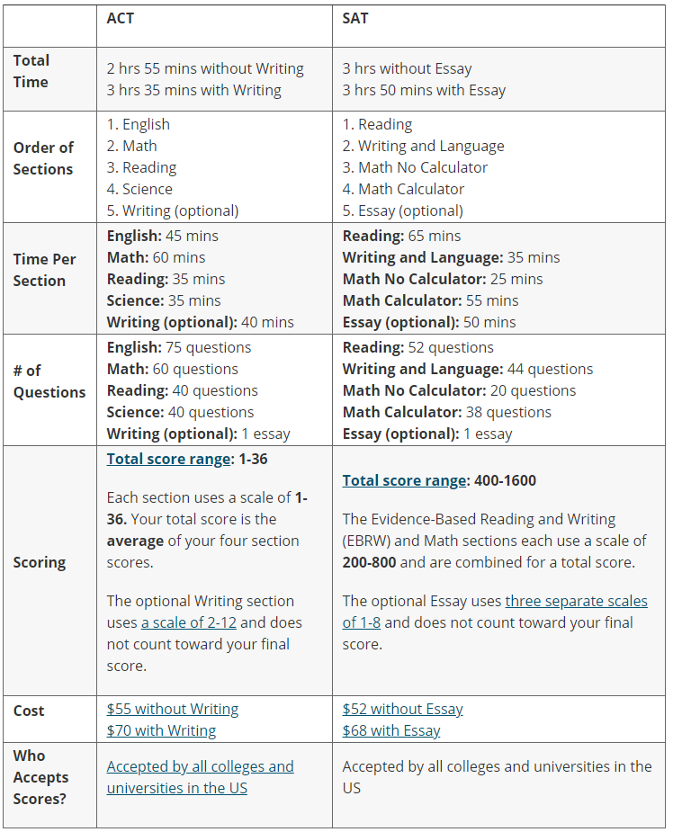
Comparison table between the ACT and SAT.
Image taken from https://www.collegeraptor.com/getting-in/articles/act-sat/preference-act-sat-state-infographic/

Slide 5
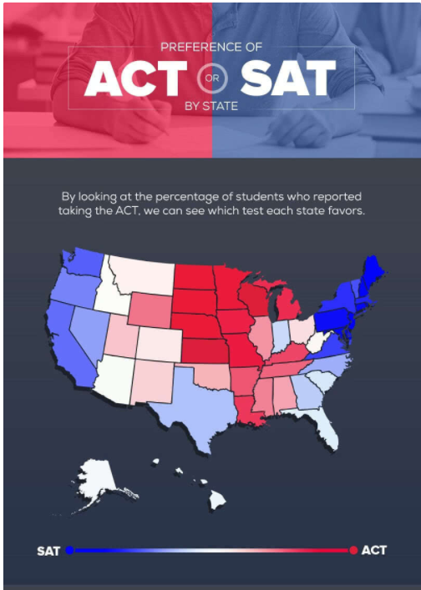
Preference of the States for ACT or SAT.
Image taken from https://www.collegeraptor.com/getting-in/articles/act-sat/preference-act-sat-state-infographic/

Slide 6

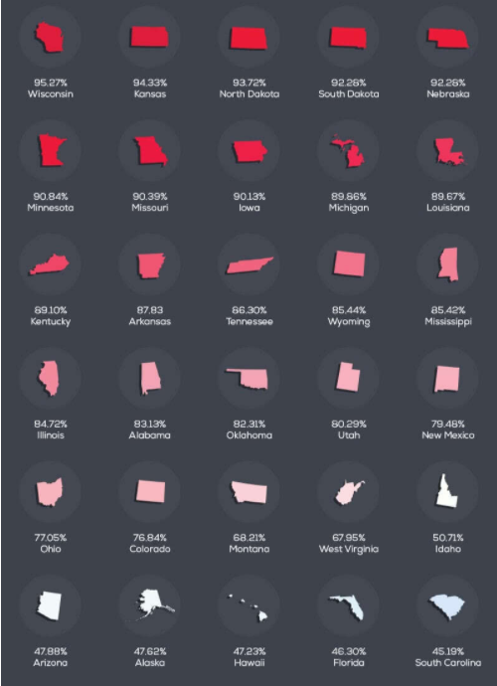
List of states with high school graduates taking ACT.
Image taken from https://www.collegeraptor.com/getting-in/articles/act-sat/preference-act-sat-state-infographic/

Slide 7
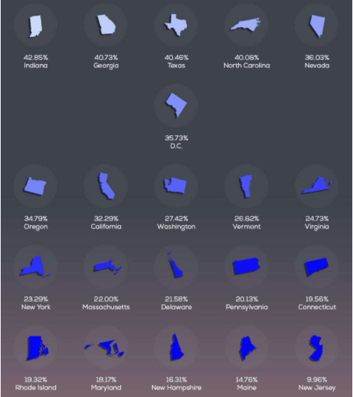
List of states with high school graduates taking SAT.
Image taken from https://www.collegeraptor.com/getting-in/articles/act-sat/preference-act-sat-state-infographic/

Slide 8
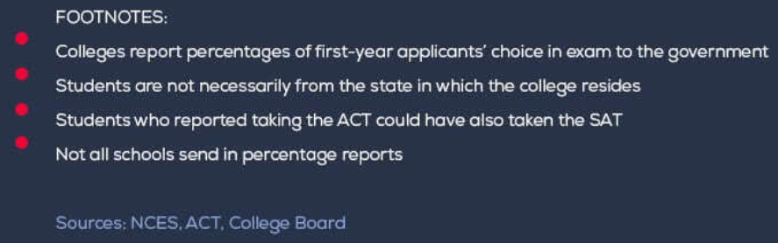
Image taken from https://www.collegeraptor.com/getting-in/articles/act-sat/preference-act-sat-state-infographic/

Slide 9
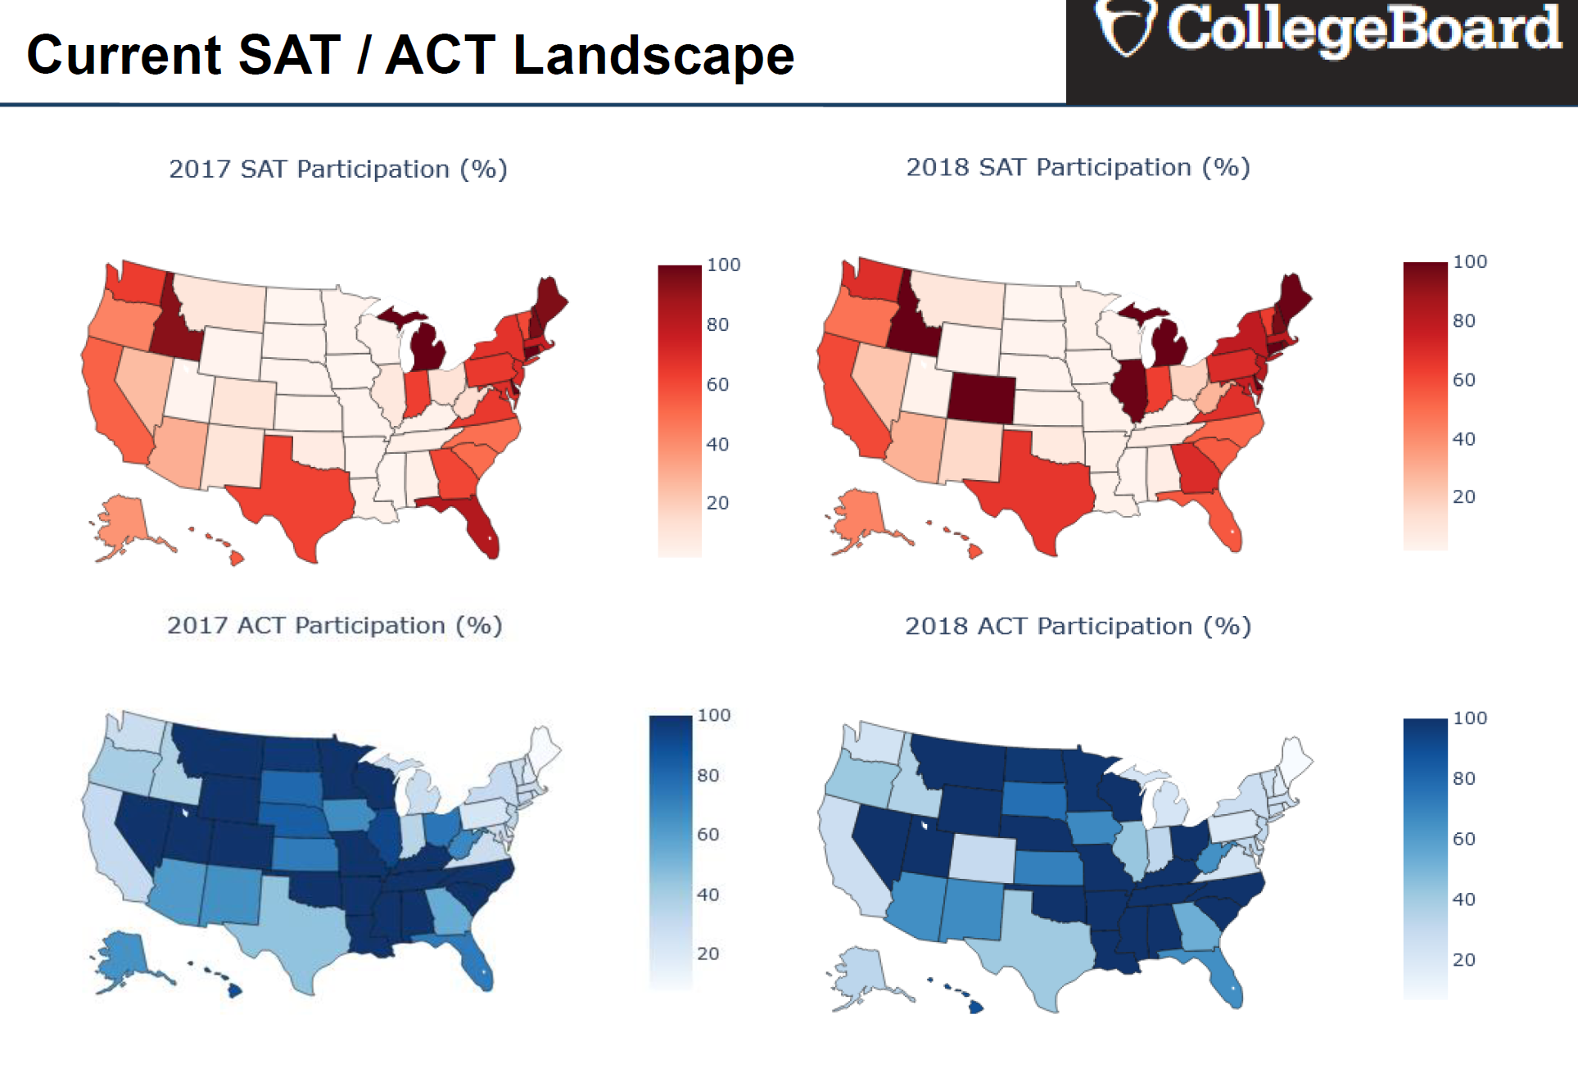
Current SAT / ACT Landscape
Image generated from Python Plotly library by Robby Sim

Slide 10
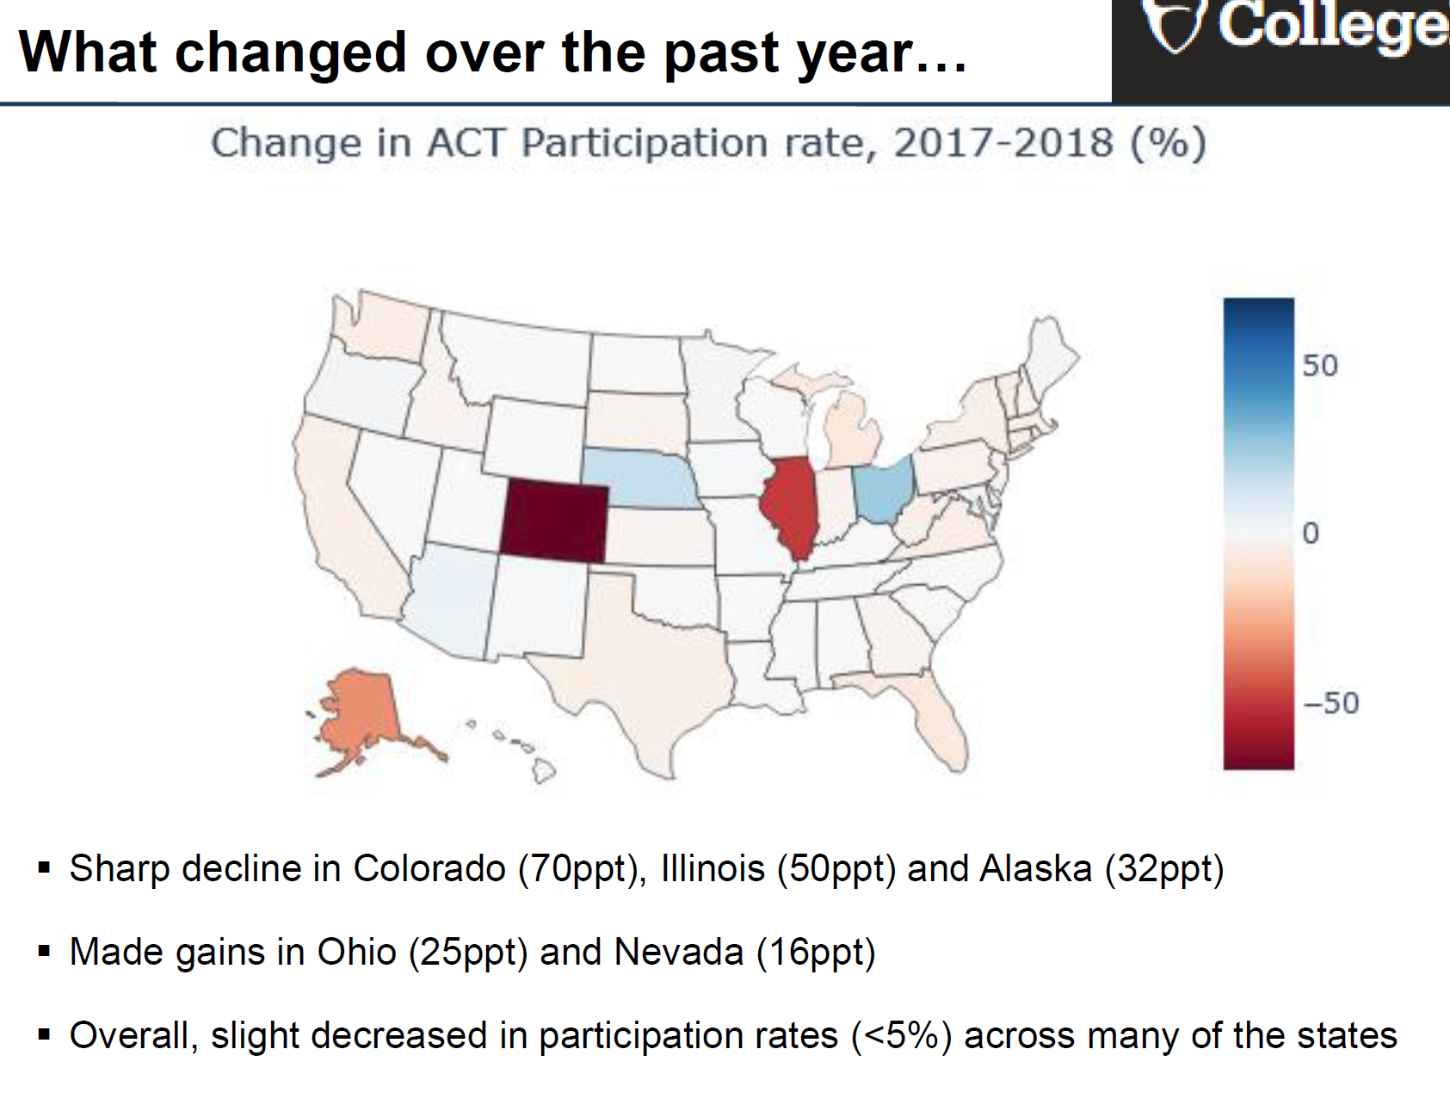
Image generated from Python Plotly library by Robby Sim

Slide 11
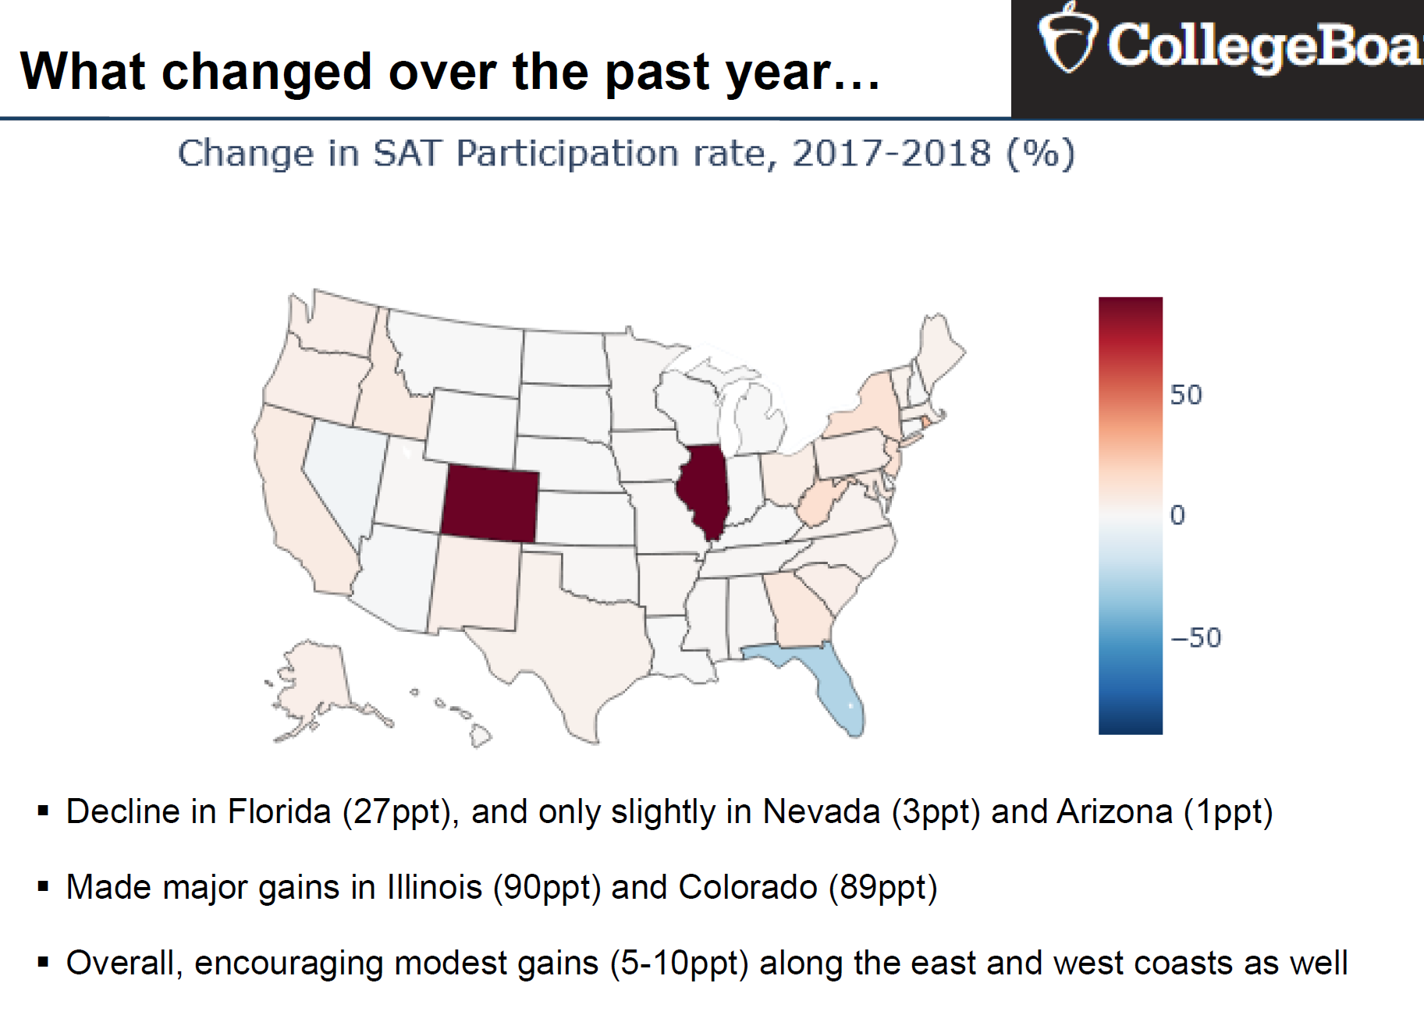
Image generated from Python Plotly library by Robby Sim

Slide 12
Participation Rates of SAT vs ACT
(between 2017 & 2018)
ACT has higher participation than SAT.
The market share of ACT is higher than SAT.
For ACT, there is a sharp decline in Colorado, Illinois and Alaska. There are gains made in Ohio and Nevada. The losses outweighs the gains, hence the overall participation rate of ACT dropped.
For SAT, there was a decline in Florida. There is a big increase in Illinois and Colorado. The gains outweigh the losses, hence the overall participation rate of SAT increased.

Slide 13
Market Share of ACT > SAT
How to increase market share of SAT?

Slide 14
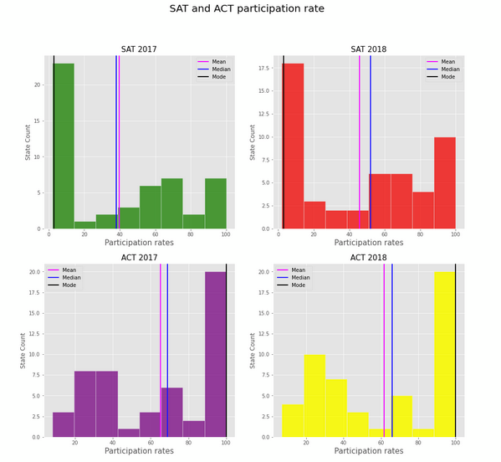
Participation rates
Many states have participation rates vary with concentrations around very high (>90%) and very low participation rate (< below 10%).
States that require testing have students usually picking one.
How can we improve the participation scores of SAT?

Slide 15
Ways to improve the SAT participation rate
States that have not mandated either the SAT or ACT can choose to enact a policy make SAT mandatory as part of it’s high school graduation requirements .
States to provide incentives such as giving students time off for test taking.
States to subsidize the test fees.
Integrate the test into high school curriculum to remove the barriers.

Slide 16
What are some key trends?

Slide 17
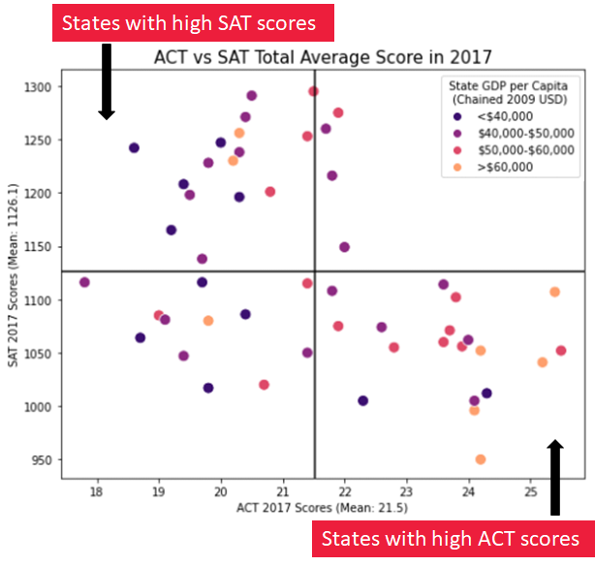
Higher GDP per Capita have higher ACT scores
States with lower GDP per Capita have higher SAT scores.
Conclusion: poorer states can still perform well on the SAT
Test Scores vs GDP

Slide 18
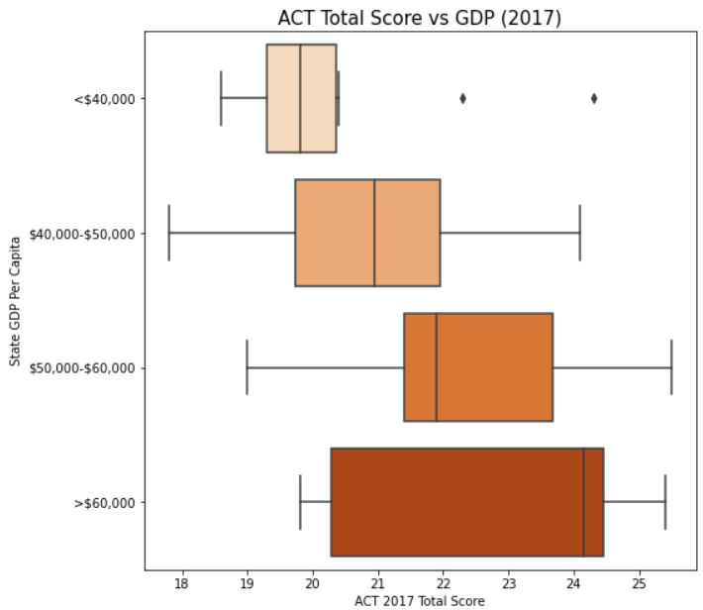
ACT Total Score vs GDP
States with a low GDP per Capita tend to have relatively poor ACT scores.
In comparison, states with a GDP per Capita of above $50,000 have higher ACT scores.

Slide 19
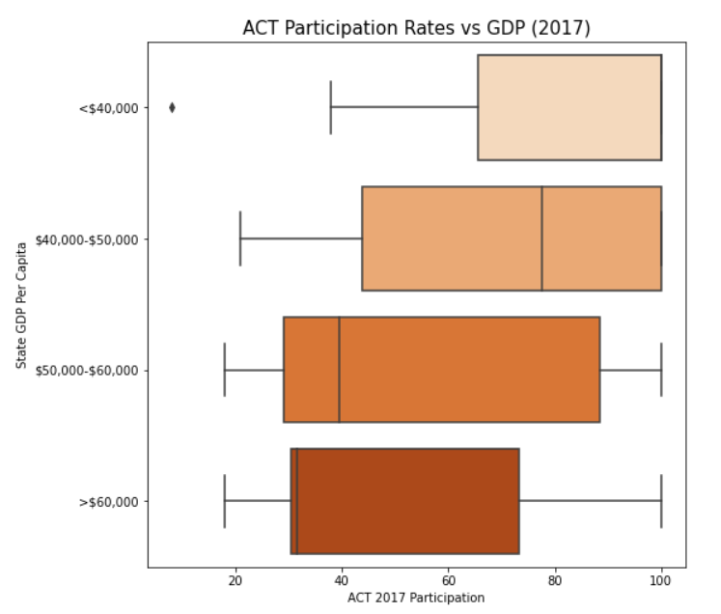
ACT Participation Rates vs GDP
Despite this, states with a low GDP per Capita have high ACT participation rates.
There are 19 states with: 1. Relatively low GDP per capita (>$50,000) 2. High ACT participation rates (>50%) 3. Below average ACT total scores (>21.5)

Slide 20
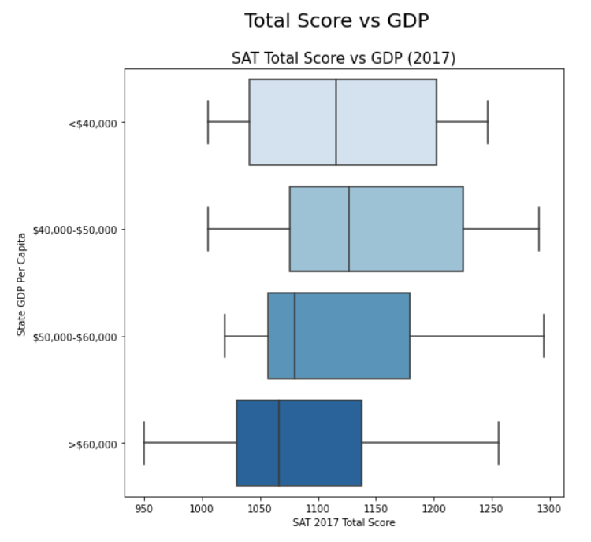
In comparison, the SAT seems to be more equitable
This could be due to policies that support low income students, such as the SAT Fee Waiver.
The SAT also assigns low income students with Landscape, an adversity score system which offers colleges information on a candidate’s neighborhood and demographic characteristics, including crime rate and poverty.

Slide 21
Which state should the College Board target?

Slide 22
Make Arizona Great Again
States | SAT / ACT Participation (2018) | Population
Arizona | 29% / 66% | 7,278,717
West Virginia | 28% / 65% | 1,792,147
New Mexico | 16% / 67% | 2,096,829
Kansas | 4% / 71% | 2,913,314
South Dakota | 3% / 77% | 884,659
Iowa | 3% / 68% | 3,155,070
Persons under 18 | 22.5%
White alone | 54.1%
Hispanic or Latino | 31.7%
American Indian and Alaska Native | 5.3%
Black or African - American alone | 5.2%
Asian, alone | 3.7%
Native Hawaiian and Other | 0.3%
Low SAT Participation (but not non-existent) - identify the potential upside
Not under statewide contract for ACT
Highly addressable market ( > 1.5m people under 18 yrs)
Low GDP (~$40,000) and low ACT scores (19.2 in 2018)
>45% of non-Whites demographics where we can advocate the support for minorities
Population & Demographics Data from US Census Bureau: https://data.census.gov/cedsci/

Slide 23
Strategies to Enter, Entrench, Replicate
Entry Strategy
Entrenchment Strategy &
Replicating Success
Identifying Data points
High School graduates
High Schools, educators, parents, state
Advocating for Minorities
Create access and support for minorities & disadvantaged groups
Collecting data
Focus groups / interviews / surveys
Qualitative / Quantitative
Creating Success Stories
Stories / Individuals that the community can identify with
SAT as assessment of choice
Analyzing data
Look for trends in motivating factors (Why SAT / ACT?)
Spot potential barriers
Replicating Success
Replicate strategies from Arizona to other states (eg, West Virginia, New Mexico etc.)
Execution
Create ease of access to and motivation to take SAT
Eg, SAT School Day
Exerting Dominance
Alleviate SAT to become a unique brand leader

Slide 24
Appendix

Slide 25
However, correlation != causation.
While the SAT may be more socially equitable than the ACT, research shows that standardized test measures generally show a negative correlation between socioeconomic status and test results (NC Gov 2017).
Our results may also be affected by the selection bias discussed earlier.
The College Board must continue to work with states to address this issue. This could mean incorporating other forms of testing such as portfolio-based assessment or adaptive testing.
With COVID-19 changing the landscape of standardized testing, the College Board must continue to adapt the SAT to the times we are now in.

Slide 26
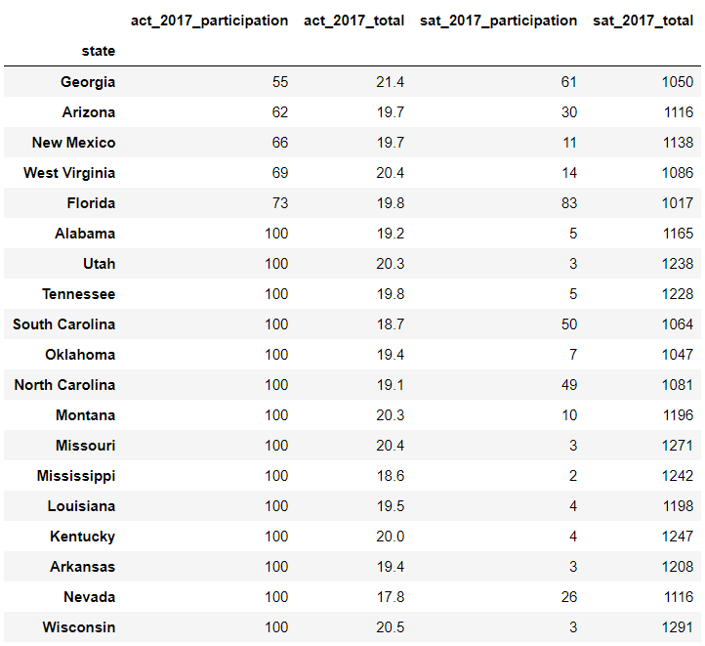
ACT
19 states with low GDP Per Capita
High ACT Participation Rates (50 - 100%)
Below average ACT scores (21.5)

Slide 27
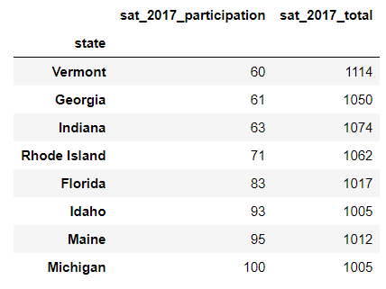
SAT
8 states with low GDP Per Capita
SAT Participation Rates (50 - 100%)
Below average SAT scores (1125)

Slide 28
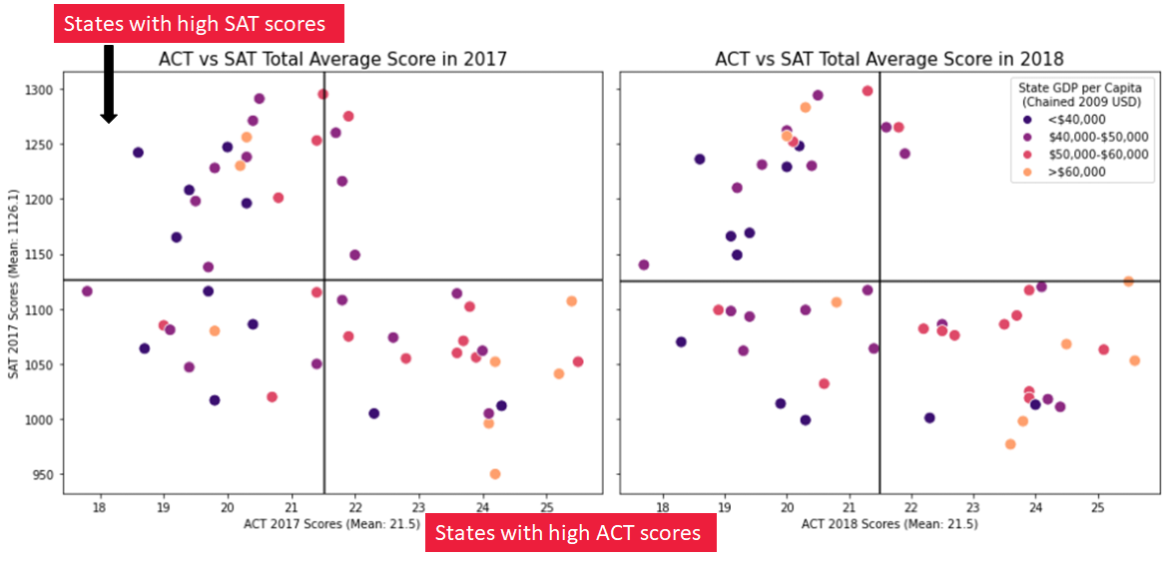
Test Scores by GDP 2017 vs 2018

